Slide 1
Nur - Tas

Slide 2
Nur - Tas
about US
“Nur-Tas” LLP
Project company Nur-Tas LLP (BIN 980140009712)
Altyn-Adam Kurylys LLP (BIN 100140009813)
Year of foundation: 1998
Head Quarter:
RK, city of Almaty, 42 Timiryazeva St., building 23A, office 236
Taxation regime: General Law (VAT 12%)
Number of employees: 40 persons
The main areas of activity:
Engineering surveys
Architectural and structural design
Partners:
KazNIISA JSC, KazGIZ LLP, KazakhTelecom JSC, Almaty Su SUE, KazTransGasAymak JSC, Alatau Zharyk Company JSC, etc.

Slide 3
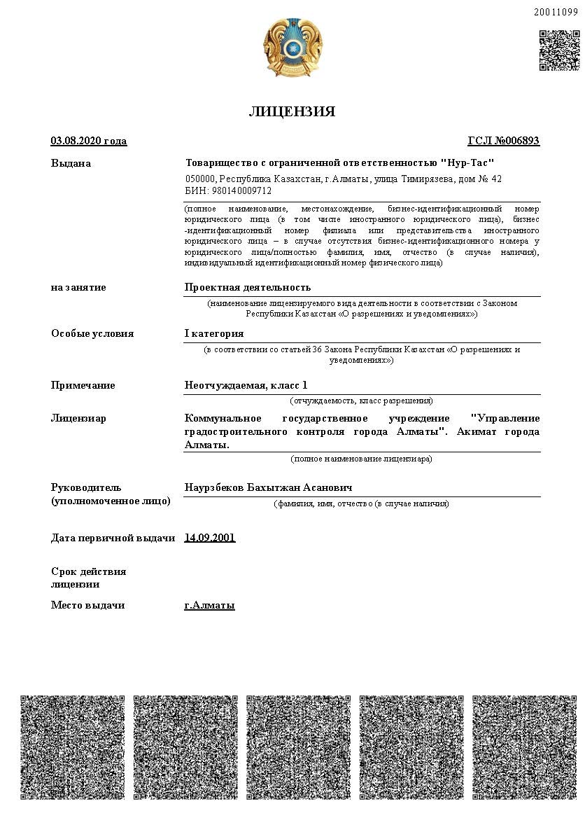
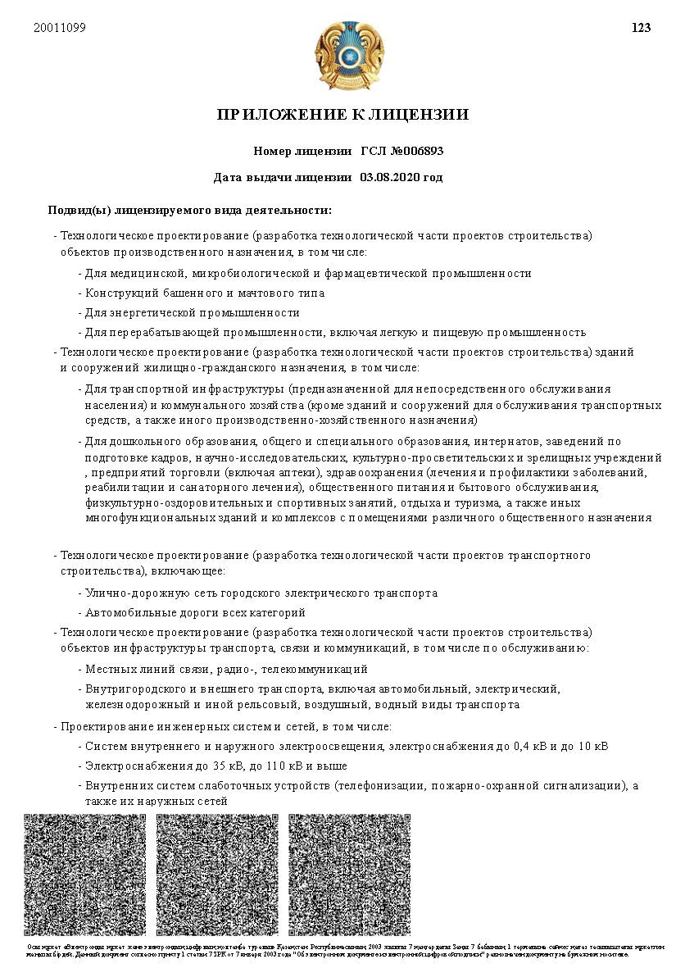

Slide 4
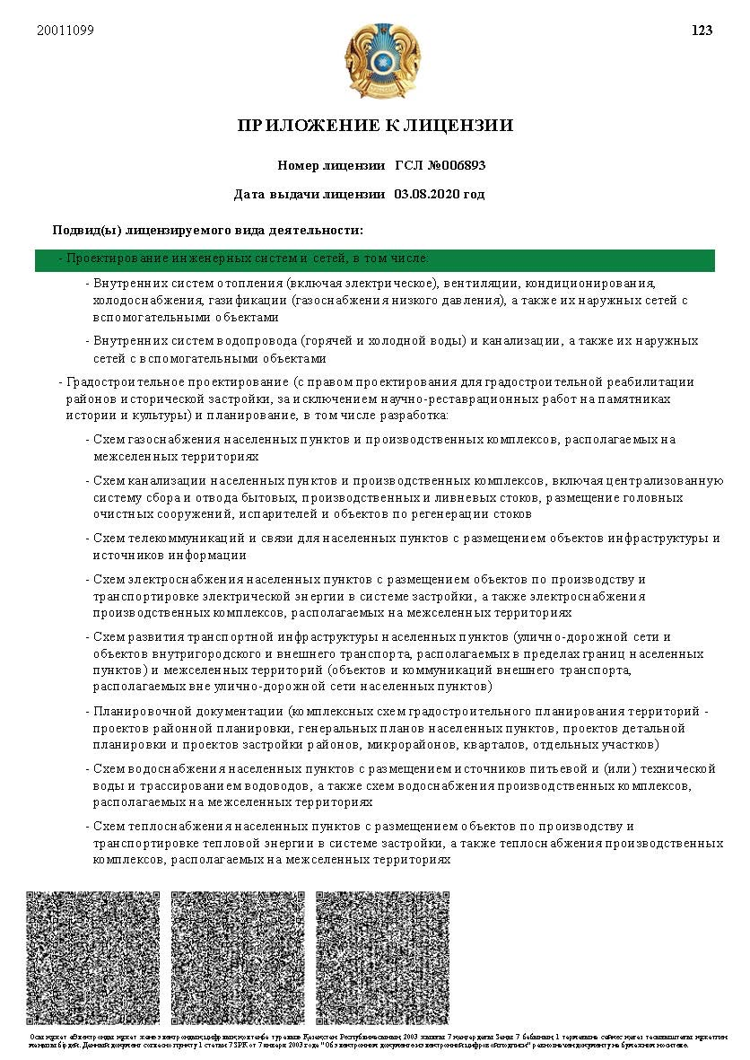
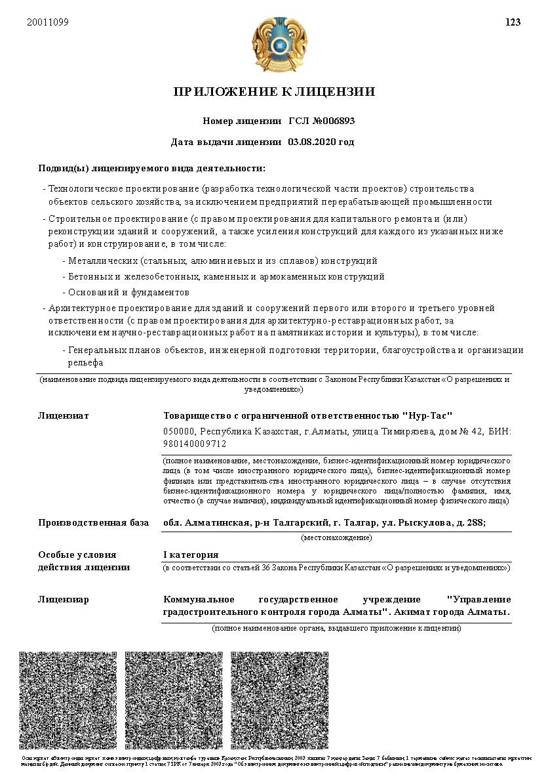

Slide 5
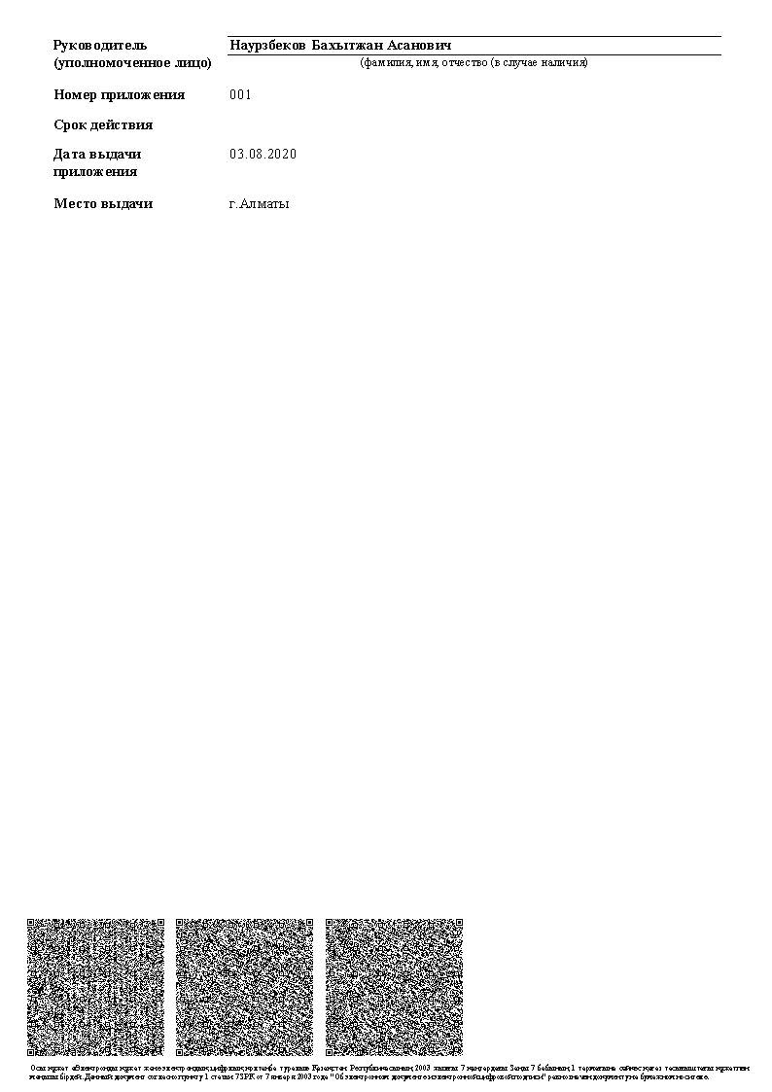
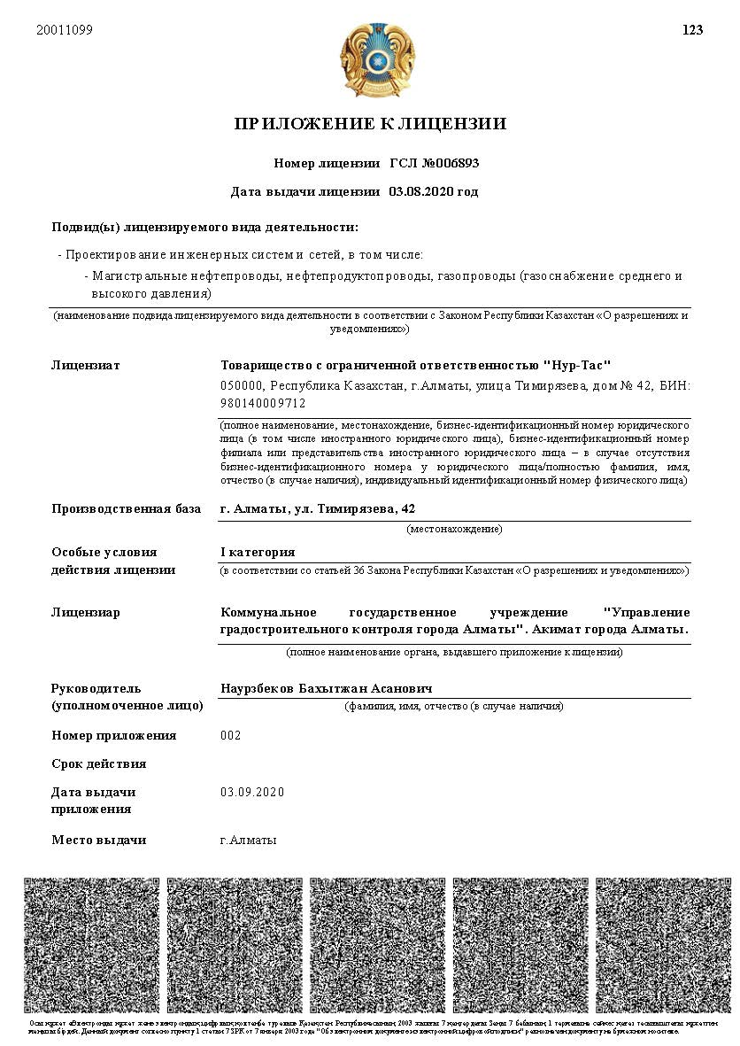

Slide 6
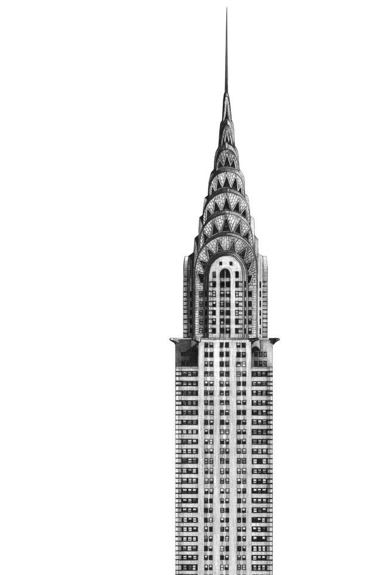
Nur - Tas
our company provides following types of services:
1
Design of engineering networks of any degree of complexity by section;
Design of internal engineering systems;
technological design, including production, industrial, cultural and amenity facilities and public catering facilities;
architectural design of buildings and structures, including development of conceptual design, exterior design, landscape design and interior design;
development of master plan schemes, including urban planning and detailed planning plans;
development of cost estimate documentation;
development of construction organization projects and projects for the production of works;
Adaptation of project documentation, according to the requirements of the SN RK for the passage of various examinations and construction;
Support of construction projects from obtaining initial permissive documentation, conducting design and quality control of design documentation of related organizations, preparation and passing of various projects, according to the requirements of RK standards, organization of independent control of construction, including design and estimate documentation, quality of construction, etc., directly during the production of construction and installation works by contractors.
2
3
4
5
6
7
8
9

Slide 7
Nur - Tas
design stages:
Obtaining initial permissive documentation (architectural and planning task, technical conditions for connecting to engineering networks)
Engineering and geodesic surveys
Passing the state
non-departmental expertise
Development of conceptual design
Development of design and estimate documentation
Geotechnical surveys
Obtaining the necessary, additional approvals and permits from the concerned state services, according to the current norms and requirements of the legislation of the Republic of Kazakhstan

Slide 8
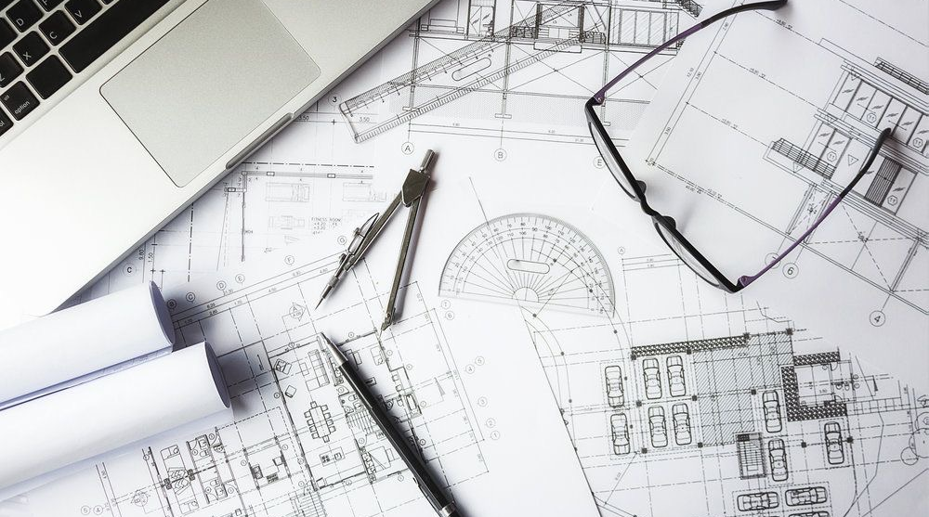
our Projects

Slide 9
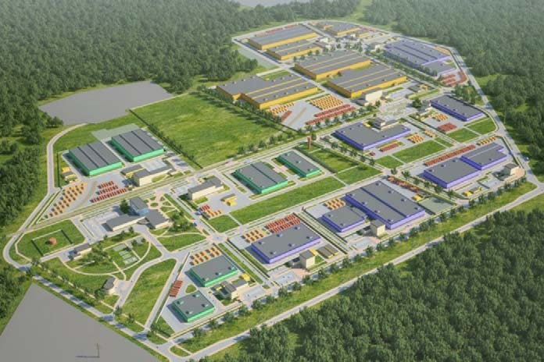
ARNA Industrial Zone, 2013.
Scope of work:
Feasibility study

Slide 10
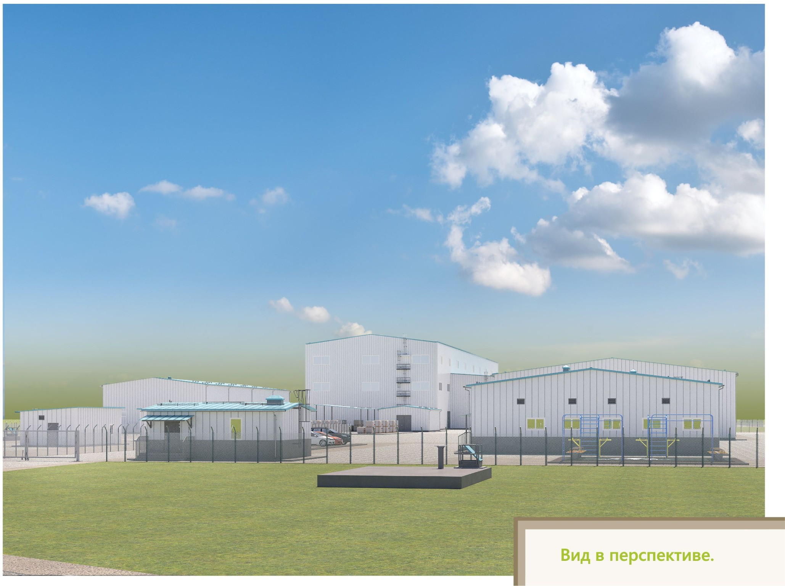
Construction of an enrichment plant for processing of technogenic mineral formations in Verkhneberezovka settlement, East Kazakhstan Region (2019)
Scope of work:
Architectural and construction solutions of buildings and structures. Engineering and technical support of the object.

Slide 11
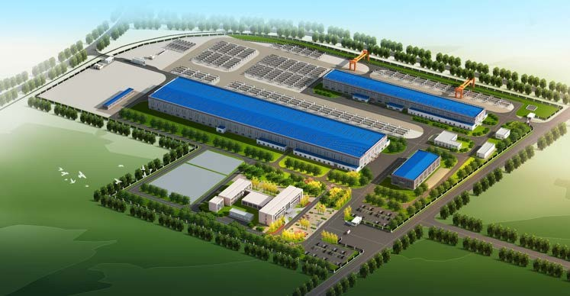
Construction of a pipeline plant (PRC) at the address: Almaty, Alatau district, industrial area, 142/1, 7 Street (2019)
Scope of work:
Engineering support for the project

Slide 12
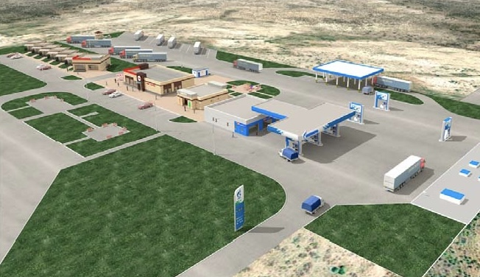
Construction of roadside service (category "B") along the road of national importance "Almaty-Shelek-Khorgos" (new road) km 286 (2019-2020)
Scope of work:
Architectural and construction solutions of buildings and structures. Engineering and technical support of the object.

Slide 13
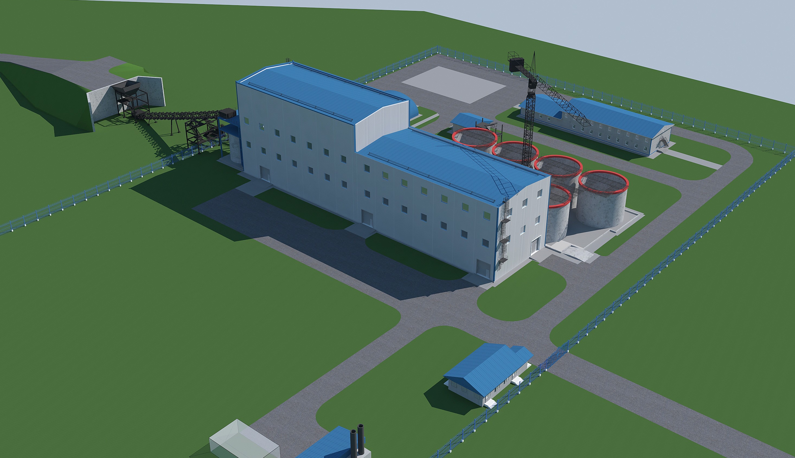
Construction of Concentration plant for processing of technogenic mineral formations "Bestobe Mine" with capacity of 2.5 million tons per year (2020)
Scope of work:
Architectural and construction solutions for buildings and structures.
Adaptation of supplier company materials.

Slide 14
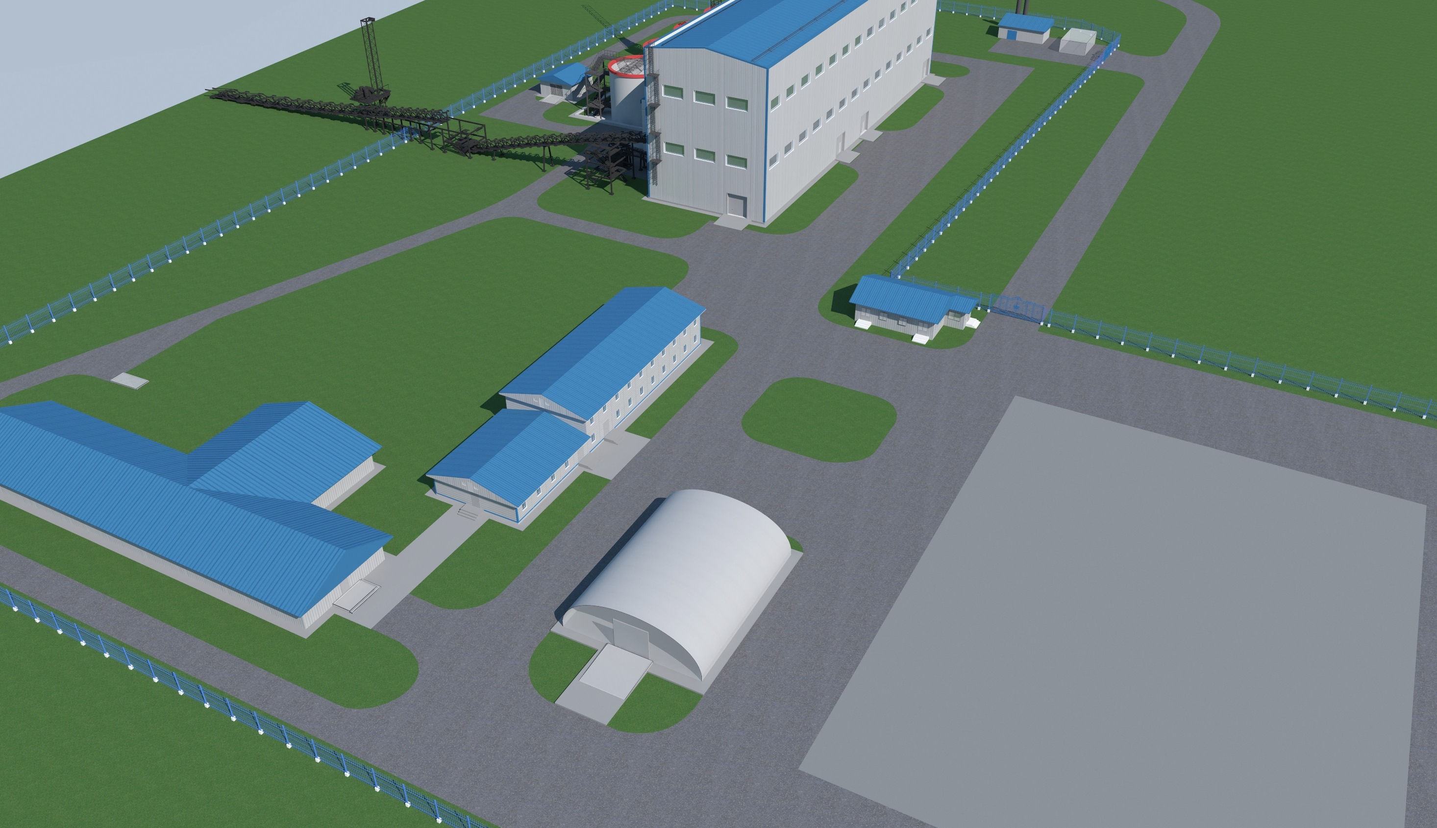
Construction of the Zholymbet Mine beneficiation plant for processing of technogenic mineral formations with a capacity of 2.5 million tons per year (2020)
Scope of work:
Architectural solutions for buildings and structures

Slide 15
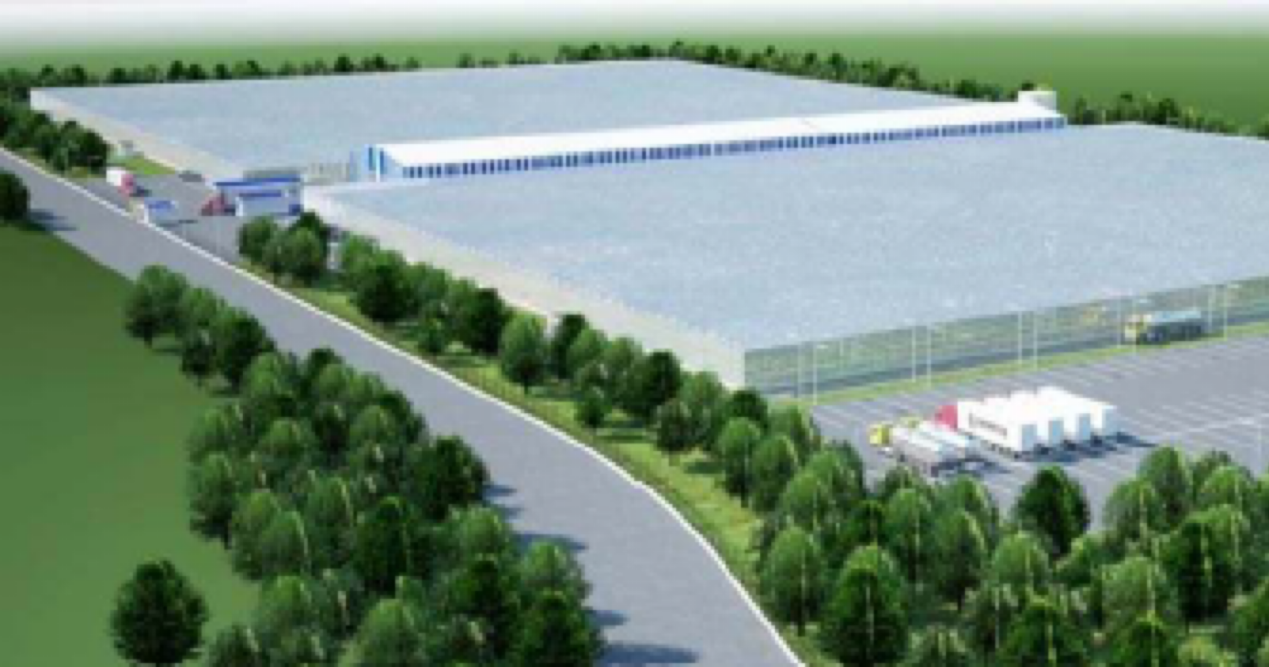
Construction of a greenhouse complex covering an area of 11.8 hectares in the Republic of Kazakhstan, West Kazakhstan region, district Baiterek, Michurinskiy rural district, 2 km from Uralsk (2020)
Scope of work:
Architectural and construction solutions for buildings and structures.
Adaptation of supplier company materials.

Slide 16
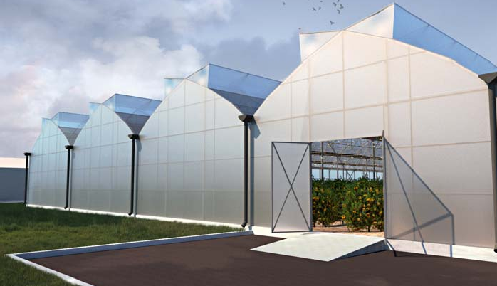
Greenhouse complex for growing lemons (Limonarium), located in Alatau district, Mambetova street, plot 1/141, Almaty (2021)
Scope of work:
Architectural solutions for buildings and structures.

Slide 17
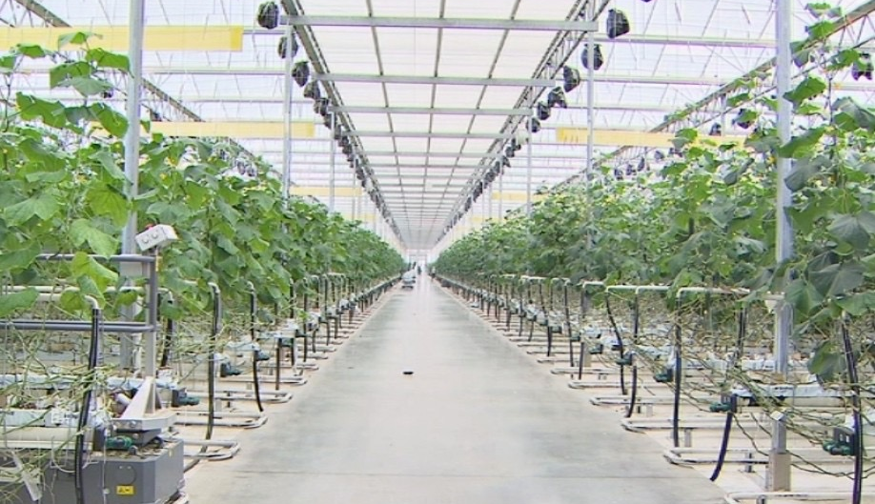
Construction of a greenhouse complex of 8 hectares in Alatau district, Industrial Zone of Almaty (2021)
Scope of work:
Architectural and construction solutions of buildings and structures.
Engineering and technical support of the object.
Adaptation of materials of the supplier company.

Slide 18
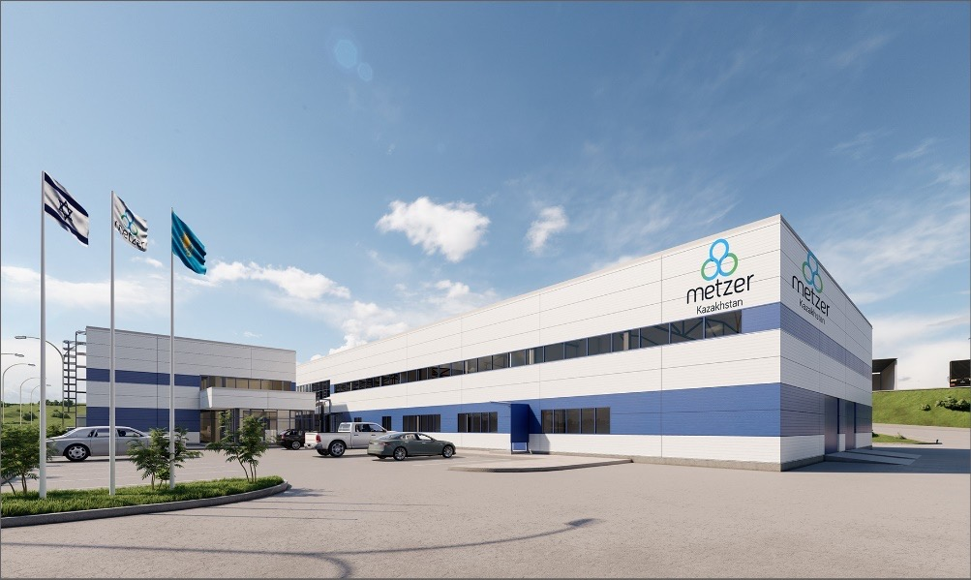
Construction of an industrial enterprise for the production of drip irrigation systems "Metzer" at: Almaty, Alatau district, Algabas district, 138-a, 7 (2022)
Scope of work:
Architectural and construction solutions of buildings and structures.
Engineering and technical support of the object.

Slide 19
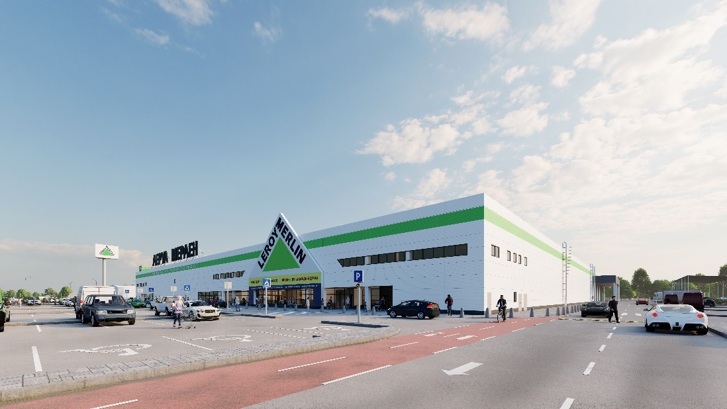
Construction of a hypermarket. Medeu district, Kuldzhinsky trakt, plot No. 22/4 (2022)
Scope of work:
Architectural and construction solutions of buildings and structures.
Engineering and technical support of the object.

