Slide 1
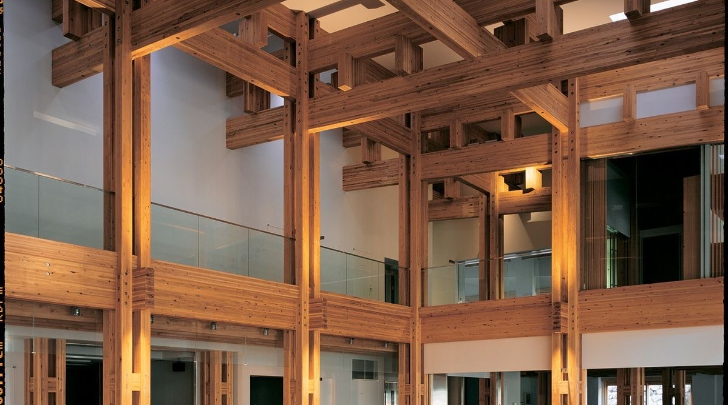
Nur - Tas

Slide 2
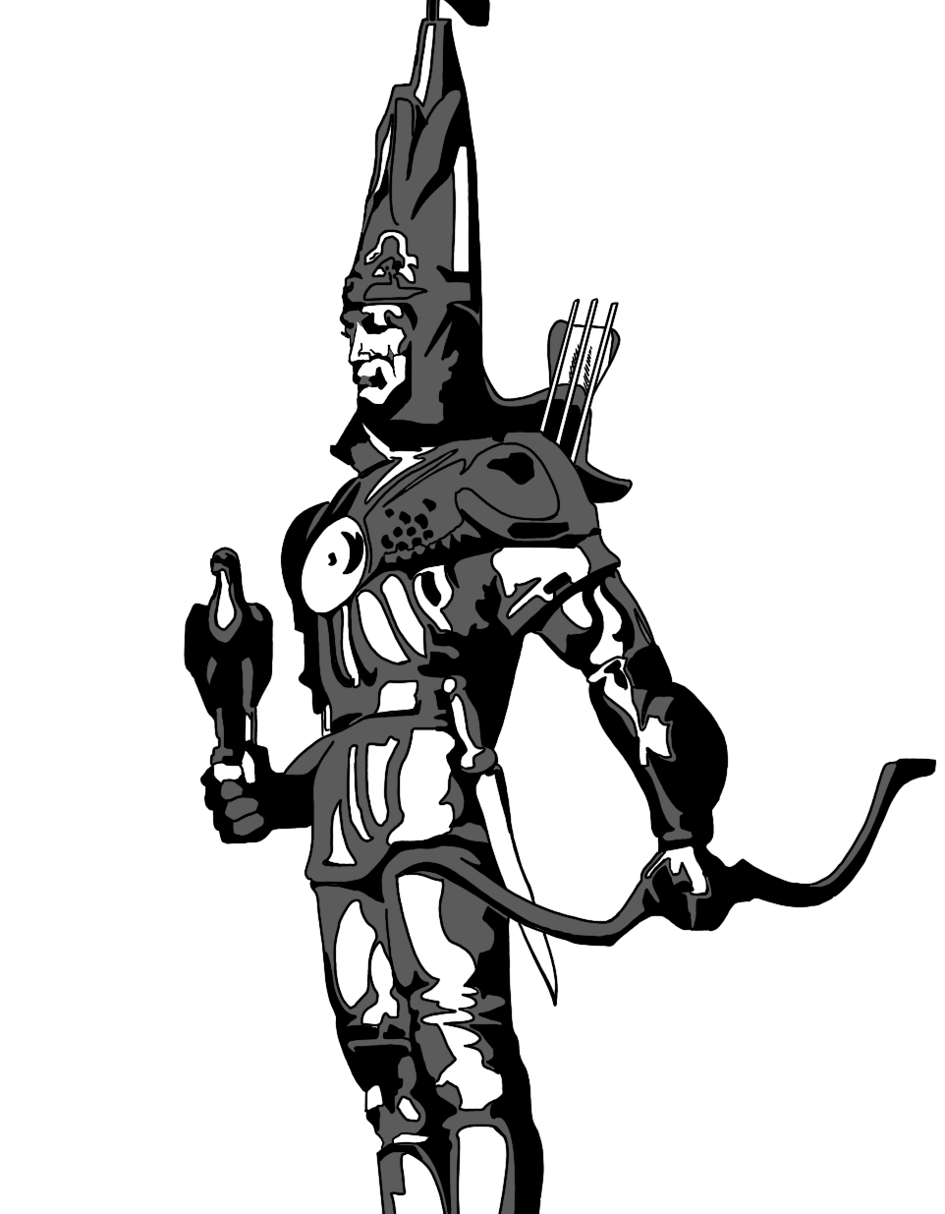
Nur - Tas
ABOUT US
Nur-Tas LLP
Design company Nur-Tas LLP (BIN 980140009712)
Altyn-Adam Qurylys LLP (BIN 100140009813)
Year of establishment: 1998
Head Office:
Republic of Kazakhstan, Almaty, 42 Timiryazev St., Building 23A, Office 236
Tax regime: general taxation (VAT 12%)
Personnel: 40 employees
Main areas of activity:
Engineering surveys
Architectural and construction design

Slide 3
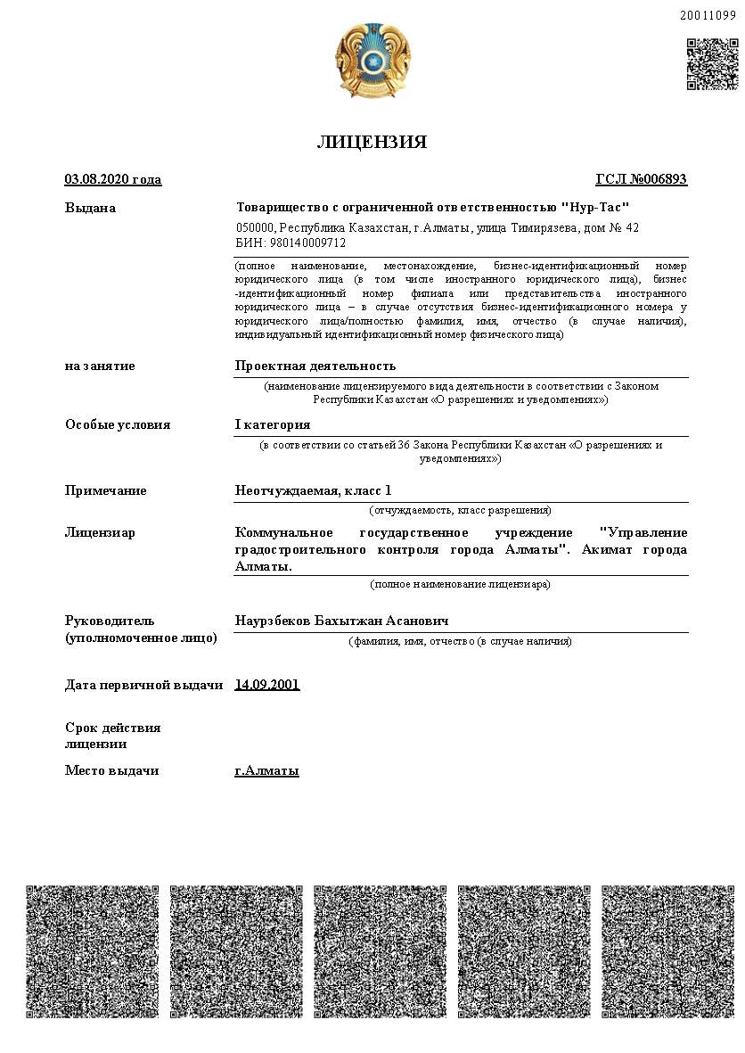
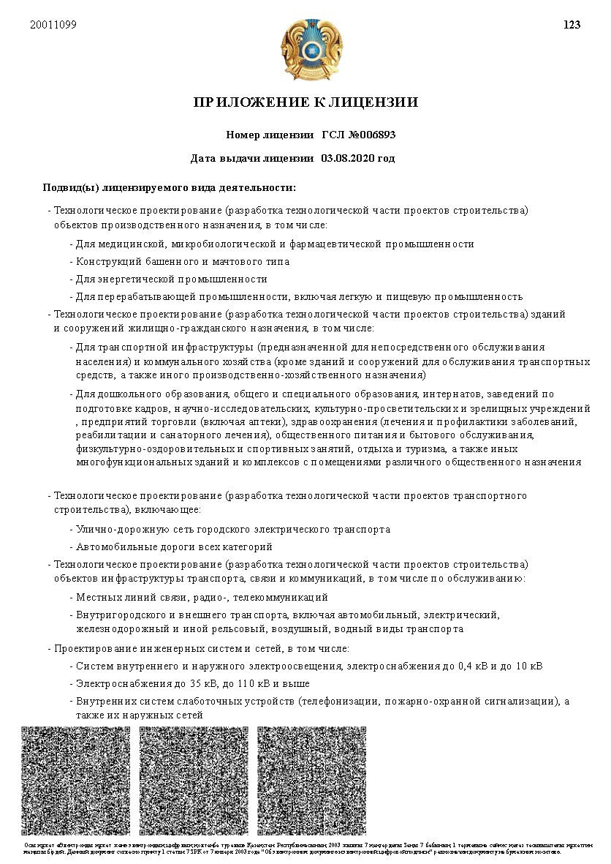

Slide 4
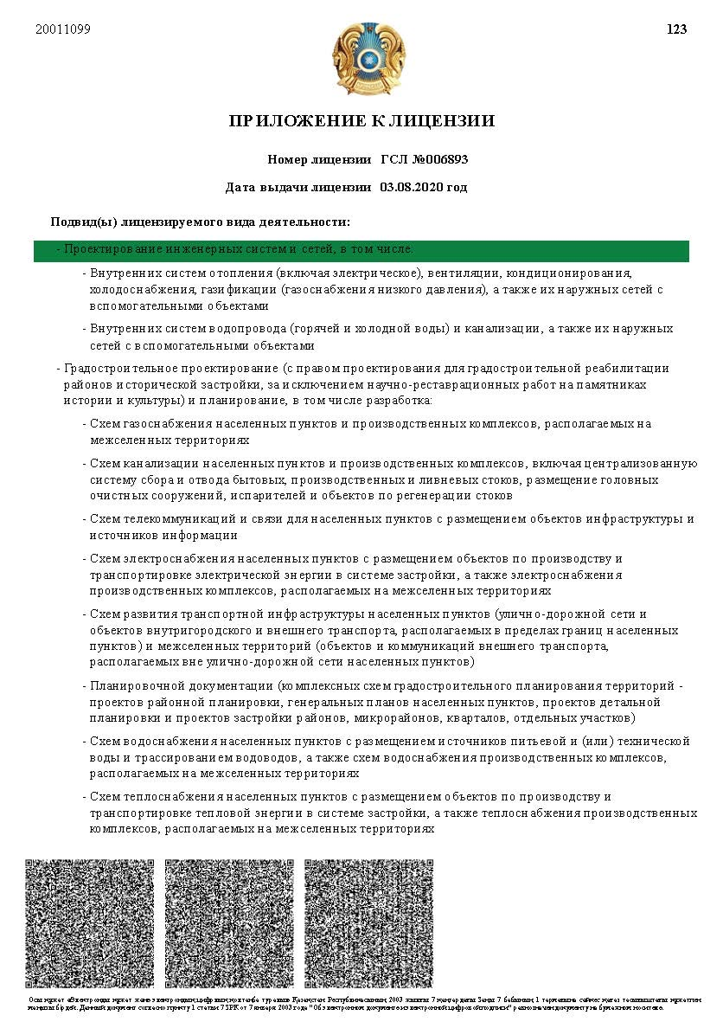
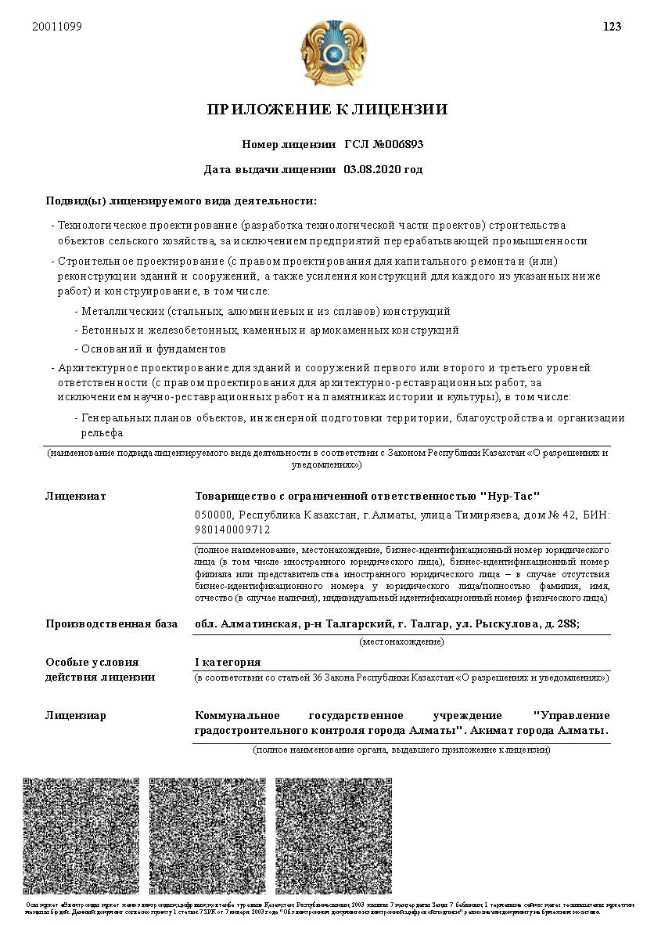

Slide 5
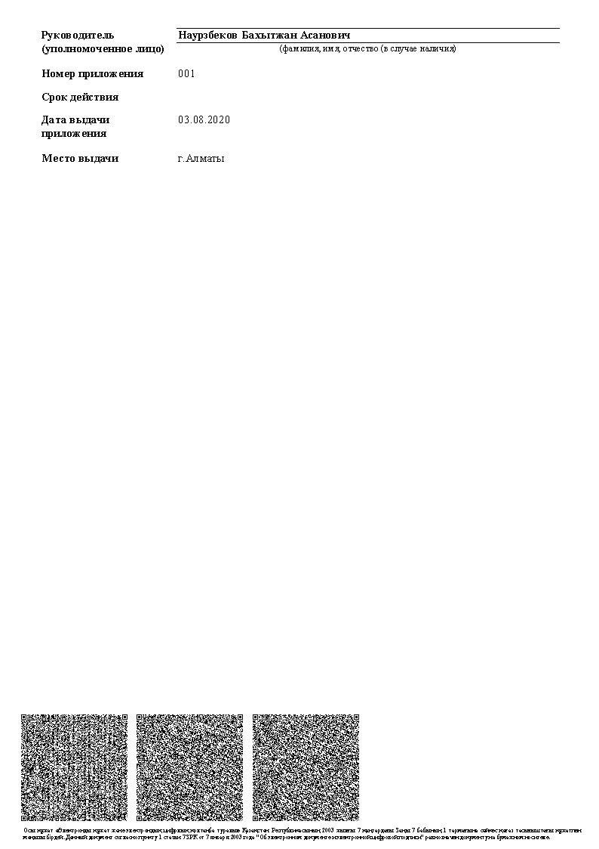
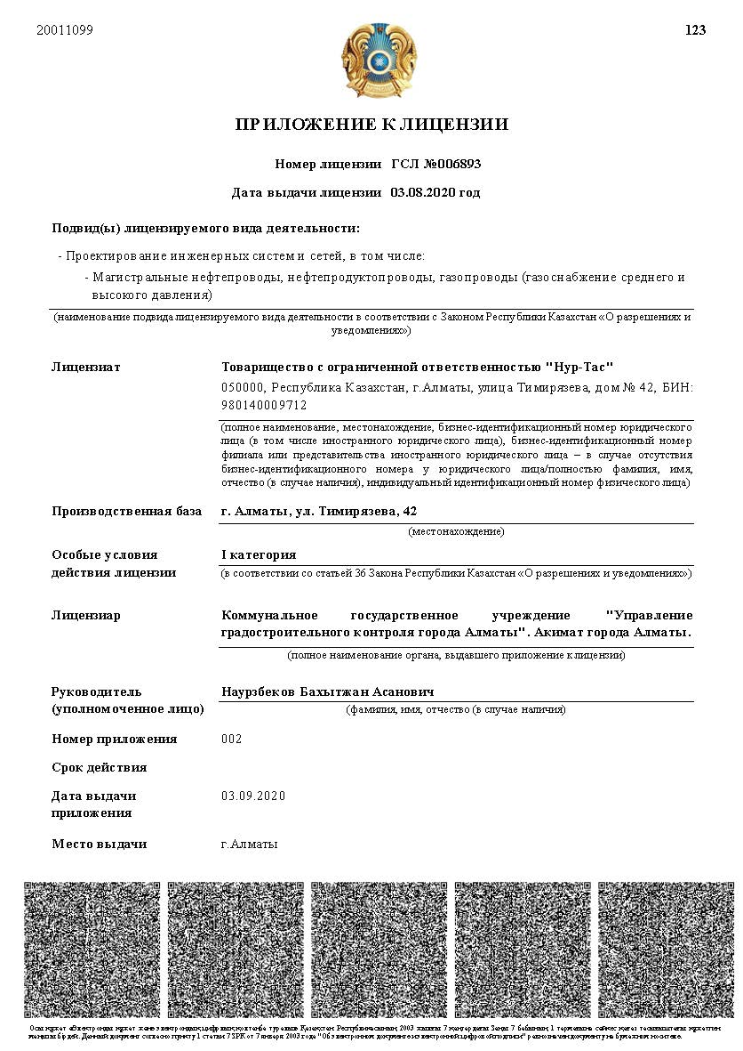

Slide 6
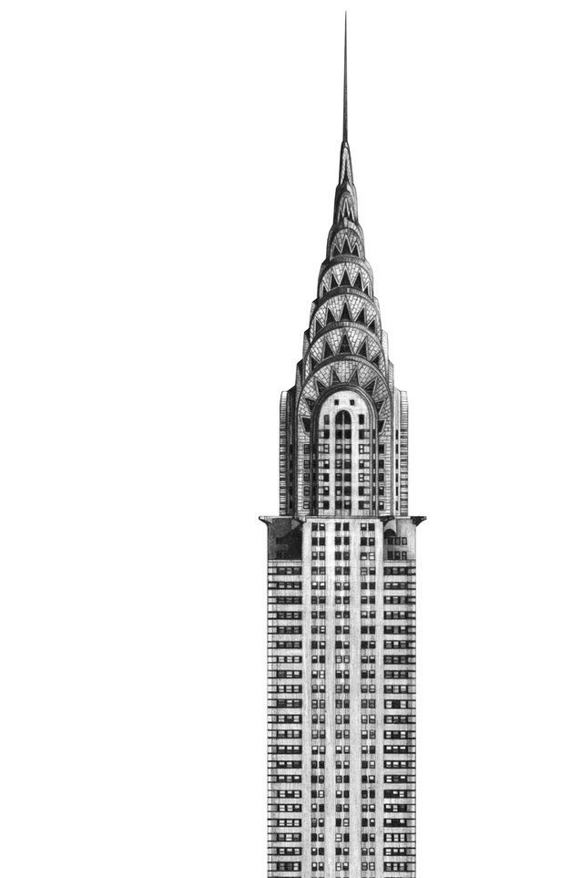
Nur - Tas
our company offers the following services:
1
design of engineering networks of any complexity by sections;
design of internal engineering systems;
technological design, including production, industrial, cultural and household facilities, and public catering facilities;
architectural design of buildings and structures, including concept design, exterior design, landscape design, and interior design;
development of master plan layouts, including urban planning and detailed planning layouts;
development of cost estimate documentation;
development of construction organization projects and work execution projects;
adaptation of design documentation in accordance with the requirements of the Construction Standards of the Republic of Kazakhstan for expert reviews and construction;
support of construction projects from obtaining initial permit documentation, design development and quality control of design documentation by related organizations, preparation and expert review of projects in accordance with applicable regulations of the Republic of Kazakhstan, and independent construction quality control, including design and estimate documentation during construction and installation works by contractors.
2
3
4
5
6
7
8
9

Slide 7
Nur - Tas
design stages:
Obtaining initial permit documentation (architectural and planning assignment, technical specifications for connection to utility networks);
Engineering and geodetic surveys
Passing state
non-departmental
expert review
Concept design development
Development of design and estimate documentation;
Engineering and geological surveys
Obtaining the required additional approvals and permits from relevant state authorities in accordance with applicable regulations and legislation of the Republic of Kazakhstan

Slide 8
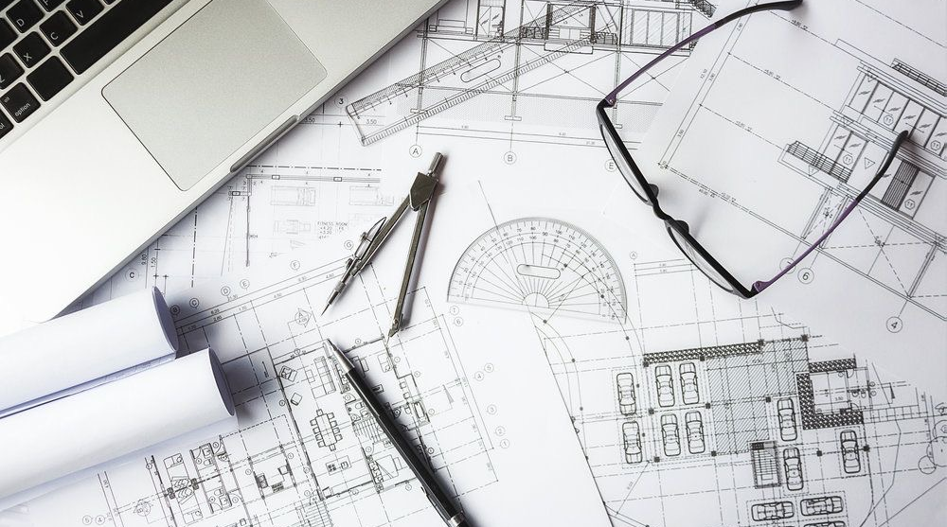
our Projects

Slide 9
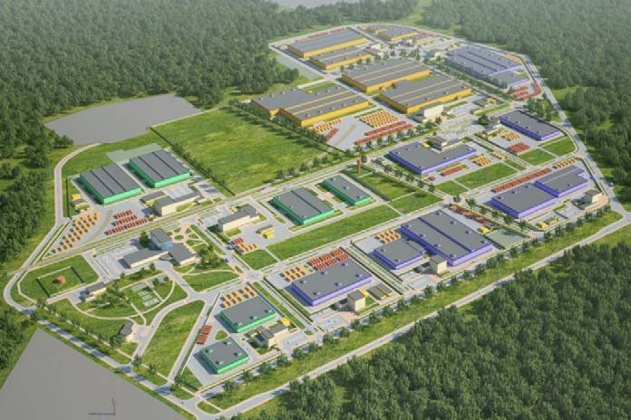
ARNA Industrial Zone, 2013
works:
Feasibility study

Slide 10
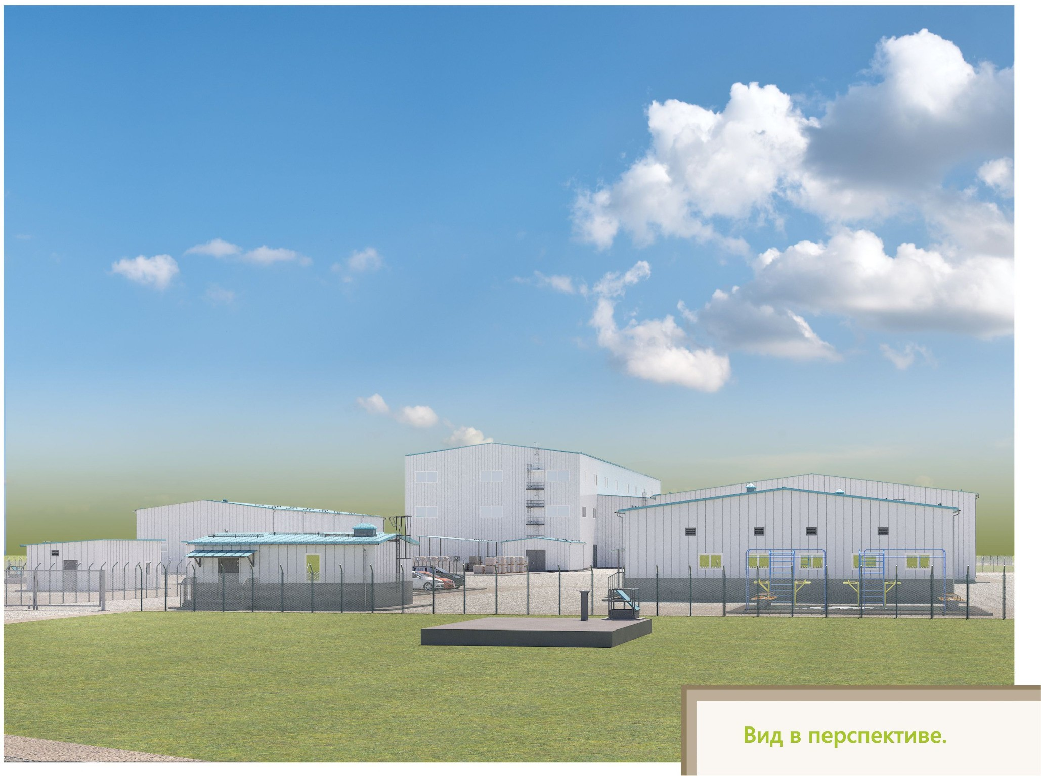
Construction of a processing plant for technogenic mineral formations in Verkhneberezovka, East Kazakhstan Region (2019)
works:
Architectural and construction solutions for buildings and structures. Engineering and technical support of the facility.

Slide 11
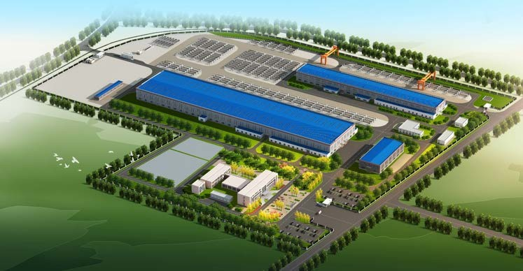
Construction of a pipe plant (PRC) at 142/1, Street 7, Industrial Zone, Alatau District, Almaty (2019)
works:
Engineering and technical support of the project

Slide 12
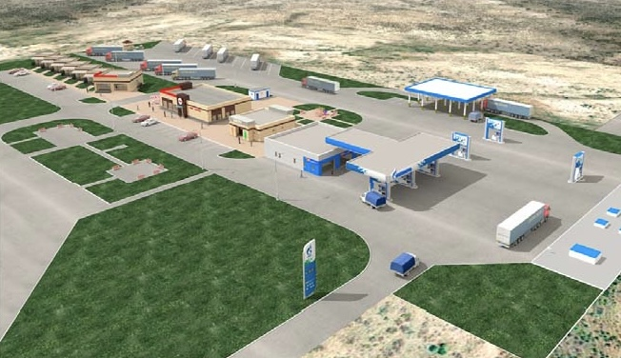
Construction of a roadside service facility, Category B, along the Almaty–Shelek–Khorgos republican highway (new road), km 286 (2019–2020)
works:
Architectural and construction solutions for buildings and structures. Engineering and technical support of the facility.

Slide 13
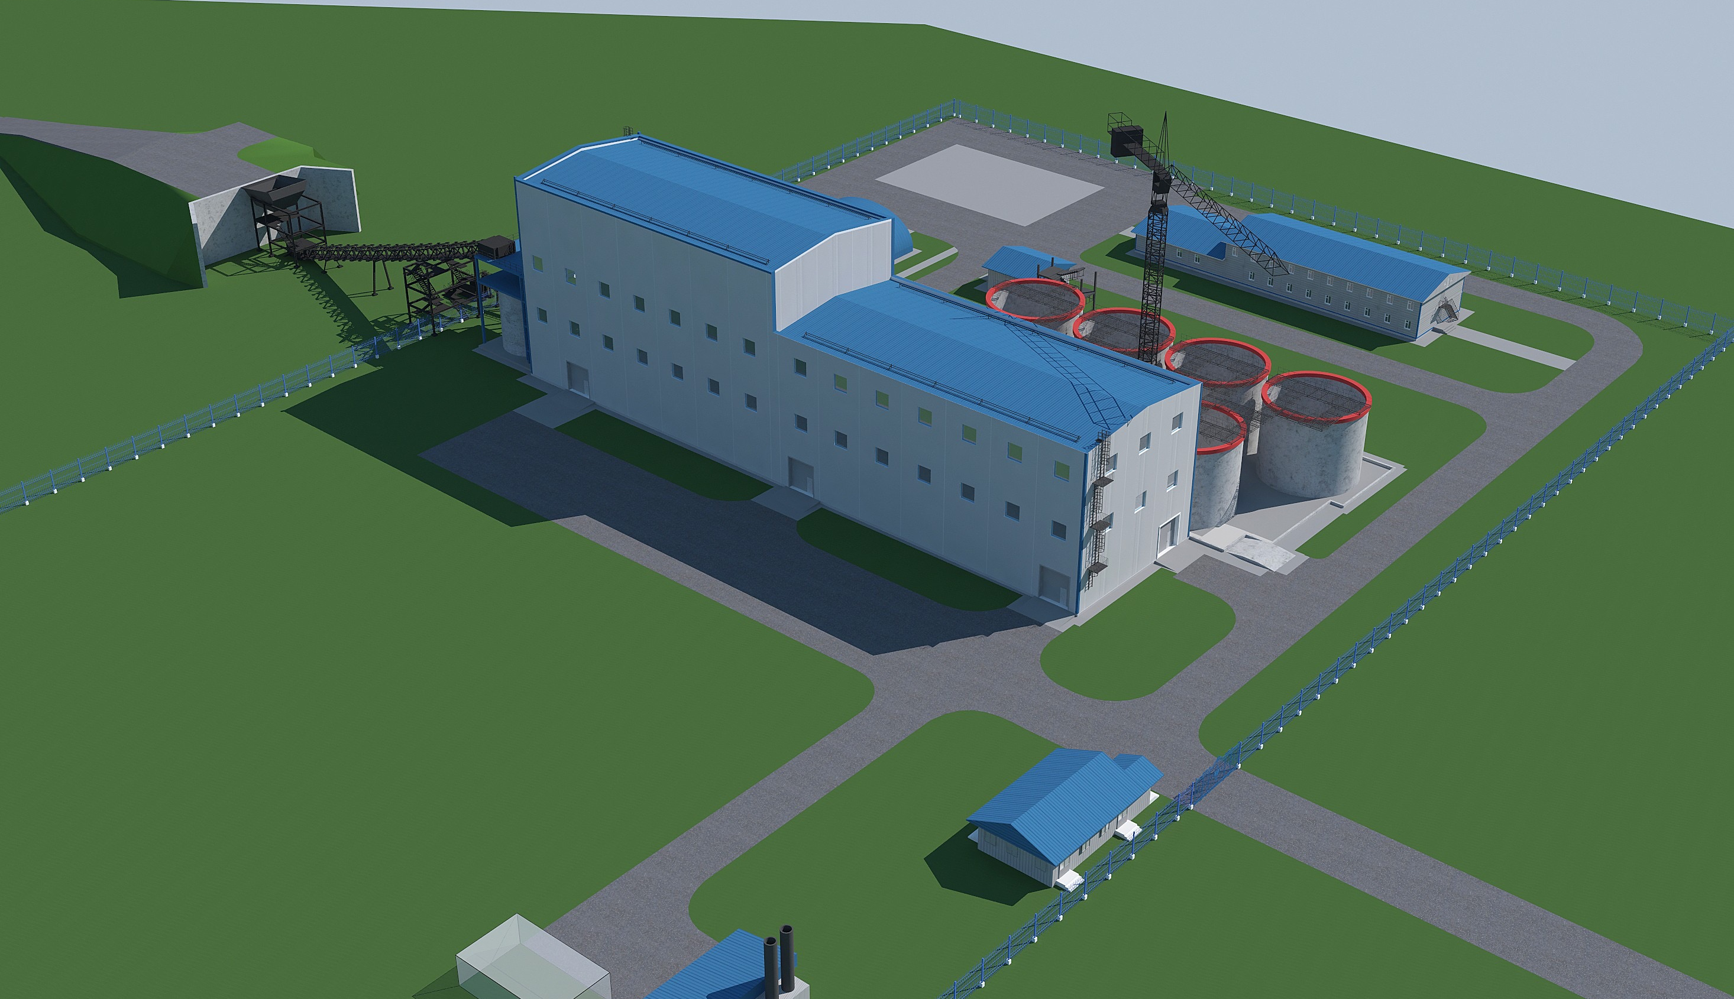
Construction of a processing plant for technogenic mineral formations at the Bestobe Mine with a capacity of 2.5 million tons per year (2020)
works:
Architectural and construction solutions for buildings and structures.
Adaptation of supplier company materials.

Slide 14
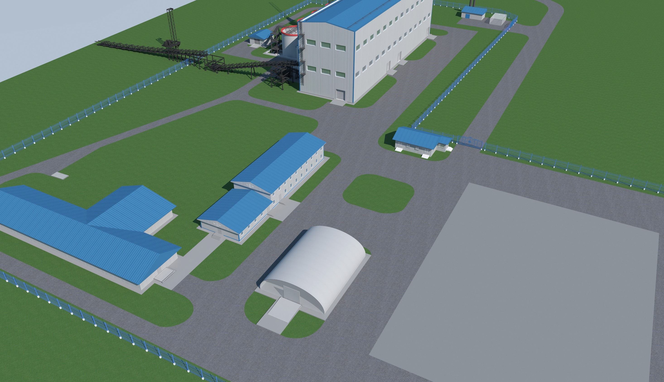
Construction of a processing plant for technogenic mineral formations at the Zholymbet Mine with a capacity of 2.5 million tons per year (2020)
works:
Architectural solutions for buildings and structures

Slide 15
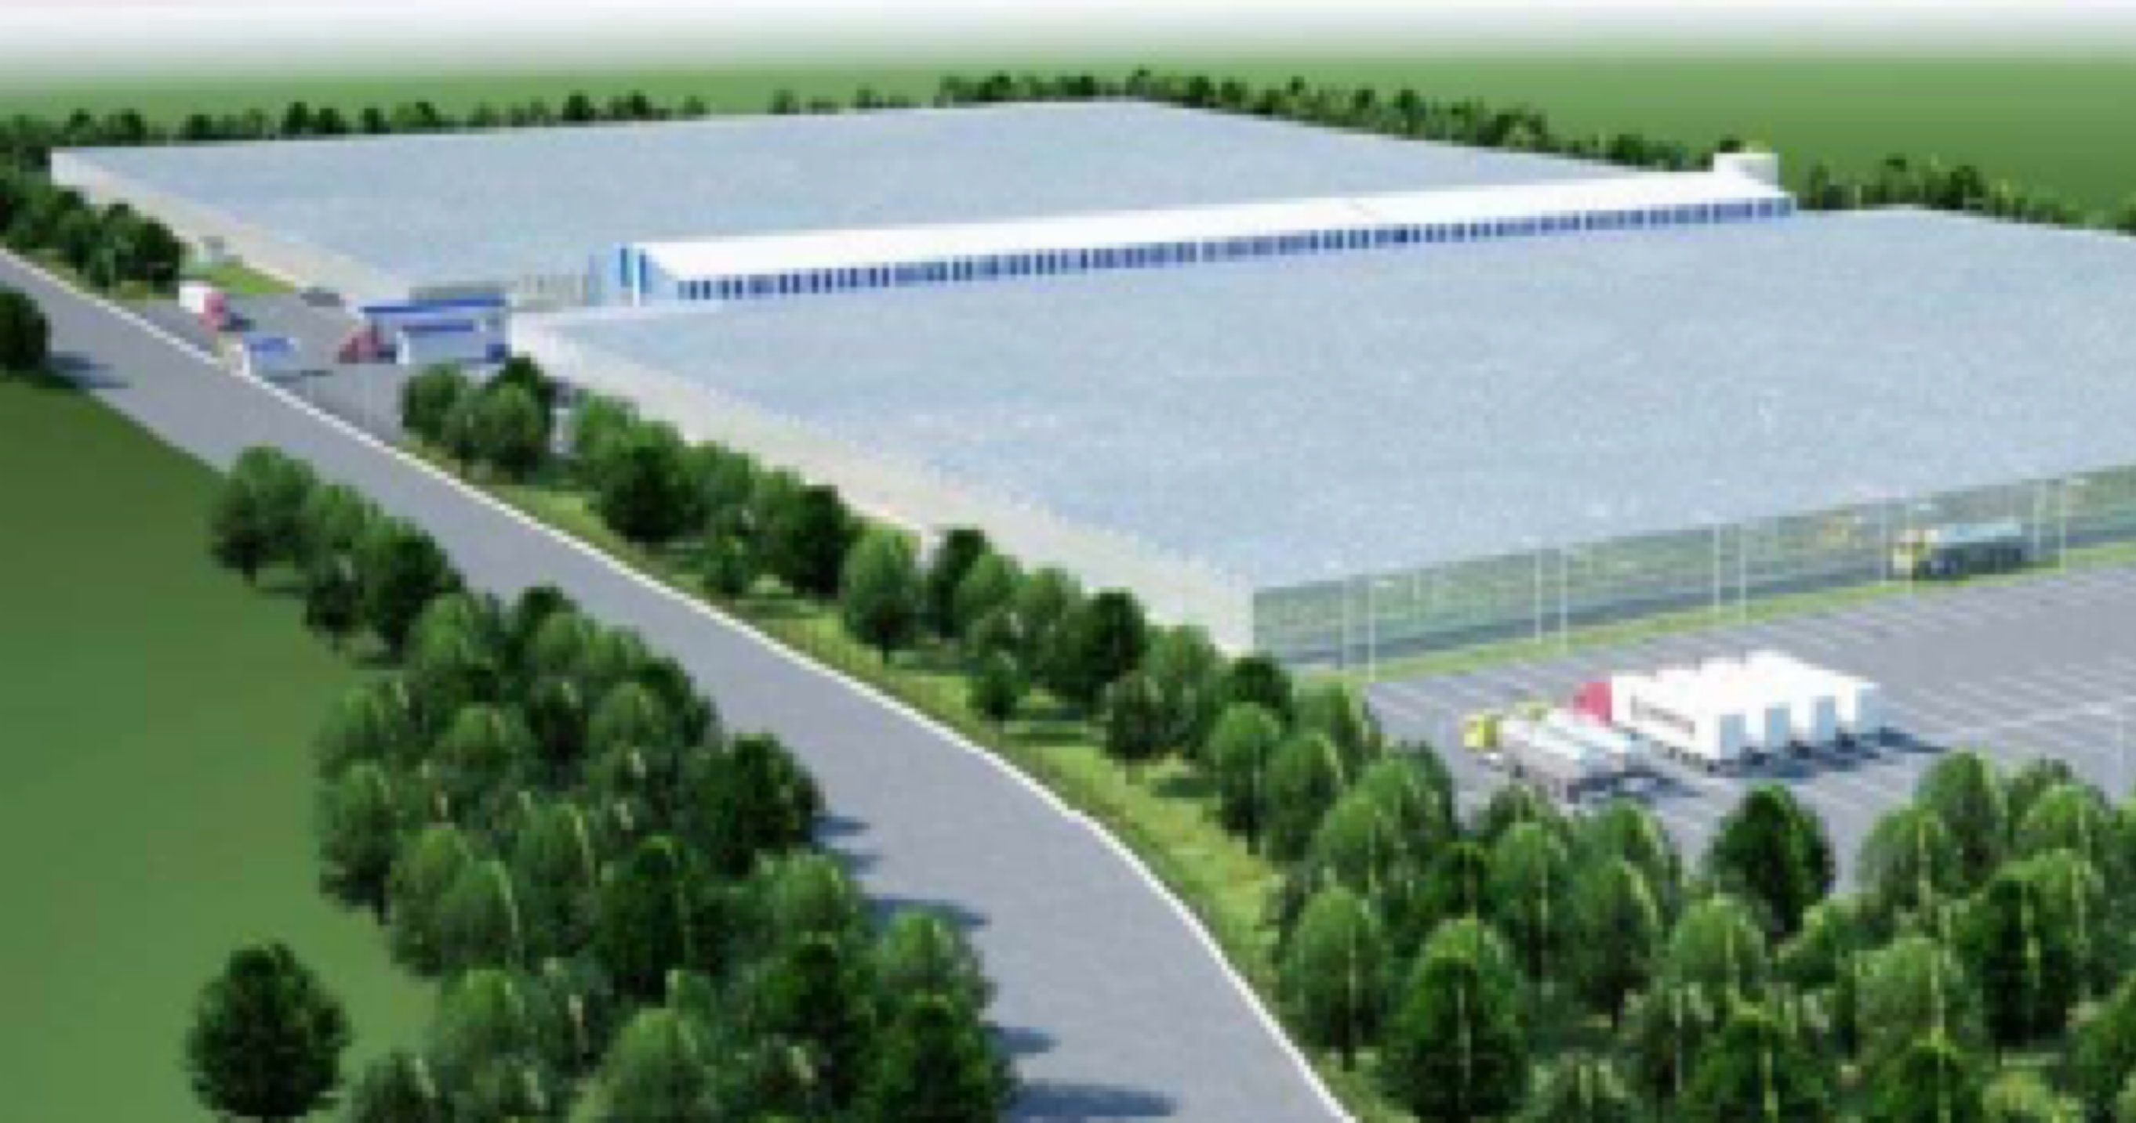
Construction of an 11.8 ha greenhouse complex in the Republic of Kazakhstan, West Kazakhstan Region, Baiterek District, Michurinsky Rural District, 2 km from Uralsk (2020)
works:
Architectural and construction solutions for buildings and structures.
Adaptation of supplier company materials.

Slide 16
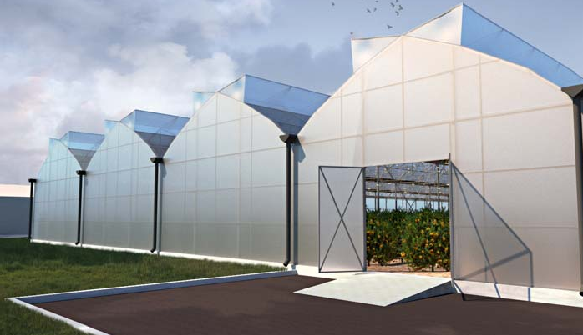
Greenhouse complex for growing lemons (Lemonarium), located at plot 1/141, Mambetov St., Alatau District, Almaty (2021)
works:
Architectural solutions for buildings and structures.

Slide 17
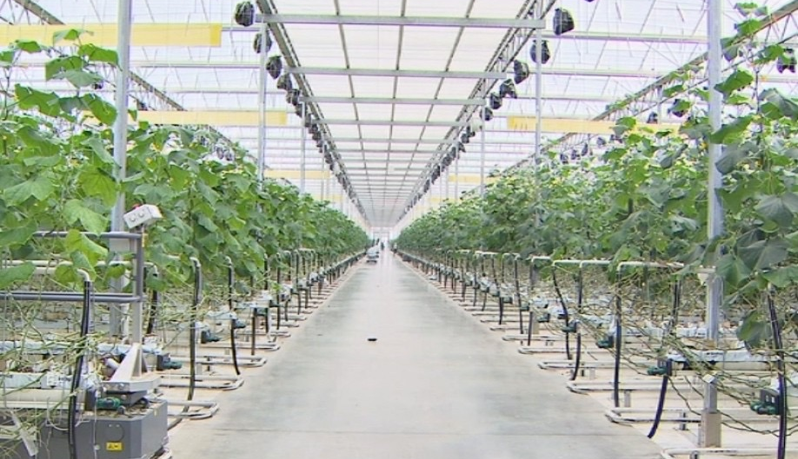
Construction of an 8 ha greenhouse complex in the Industrial Zone of Alatau District, Almaty (2021)
works:
Architectural and construction solutions for buildings and structures.
Engineering and technical support of the facility.
Adaptation of supplier company materials.

Slide 18
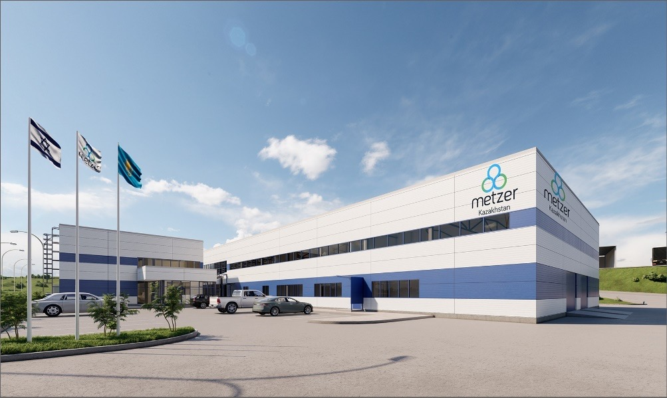
Construction of an industrial enterprise for the production of Metzer drip irrigation systems at 138-a, Street 7, Algabas microdistrict, Alatau District, Almaty (2022)
works:
Architectural and construction solutions for buildings and structures.
Engineering and technical support of the facility.

Slide 19
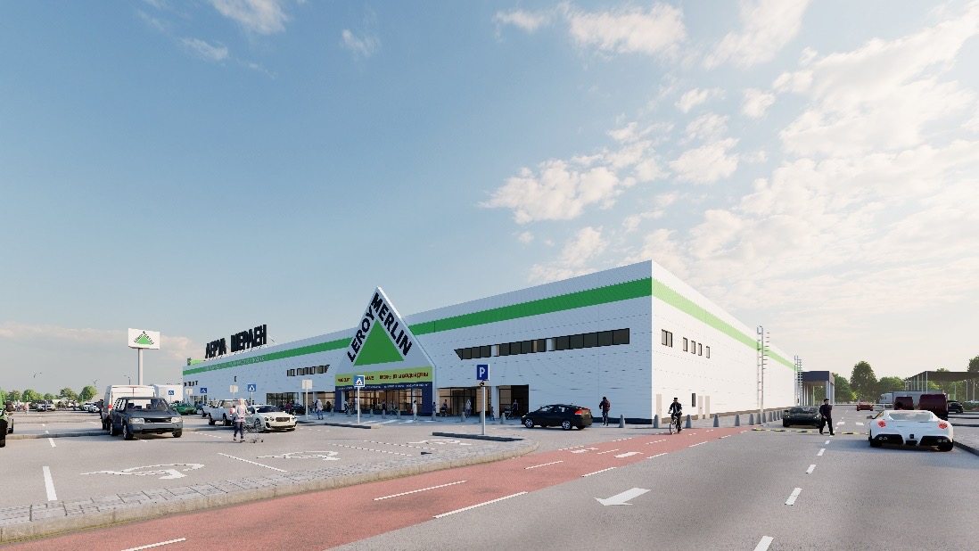
Construction of a hypermarket. Medeu District, Kuldzhinsky Tract, plot No. 22/4 (2022)
works:
Architectural and construction solutions for buildings and structures.
Engineering and technical support of the facility.

Slide 20
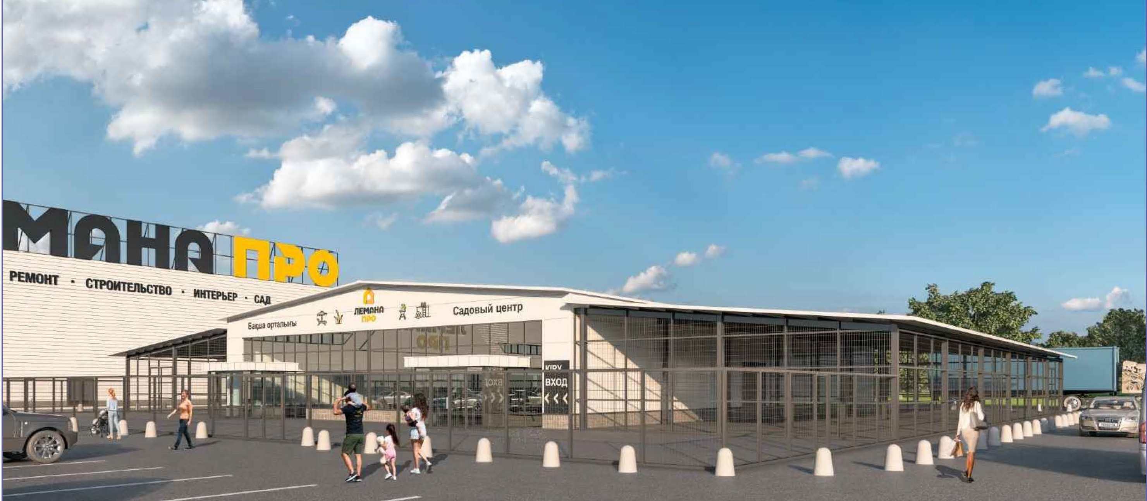
Expansion of the Lemana Pro building materials hypermarket with construction of a garden center at plot 8970, Almaty–Bishkek highway, Irgeli village, Irgeli rural district, Karasay District, Almaty Region (2024)
works:
Architectural and construction solutions for buildings and structures.
Engineering and technical support of the facility.

Slide 21
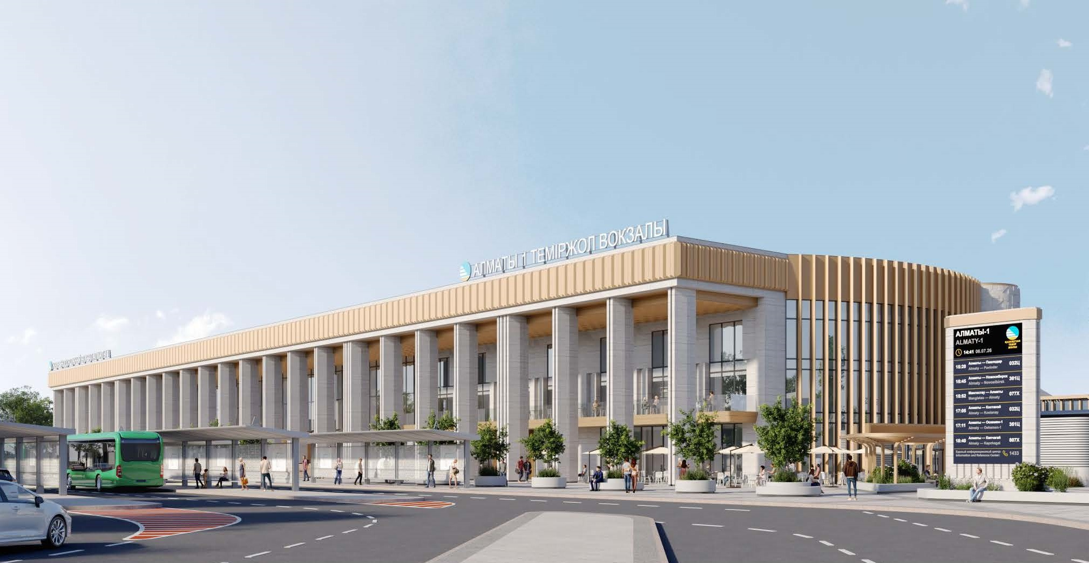
Reconstruction of the Almaty-1 railway station located at 5 Stantsionnaya Street, Turksib District, Almaty (2025–2026)
works:
Architectural and construction solutions for buildings and structures.
Engineering and technical support of the facility.

